Slide 1
The Impact of COVID-19 on Education in Essex County, New Jersey
By Aaliyah Hänni
December 7th, 2021

Slide 2
Research Question
1. What does the change in school enrollment for all grades look like when comparing the 2017-18, 2018-19 and 2019-20 school years, for all K-12 public schools in Essex County, New Jersey?
2. What is the difference in test scores when comparing the 2017-18, 2018-19 and 2019-20 school years, for all K-12 public schools in Essex County, New Jersey?
3. What is the change in 4 and 5-year school graduation rates for the last 4 years, for all public schools in Essex County, New Jersey?
How the COVID-19 pandemic impact K-12 public school students in Essex County, New Jersey?

Slide 3
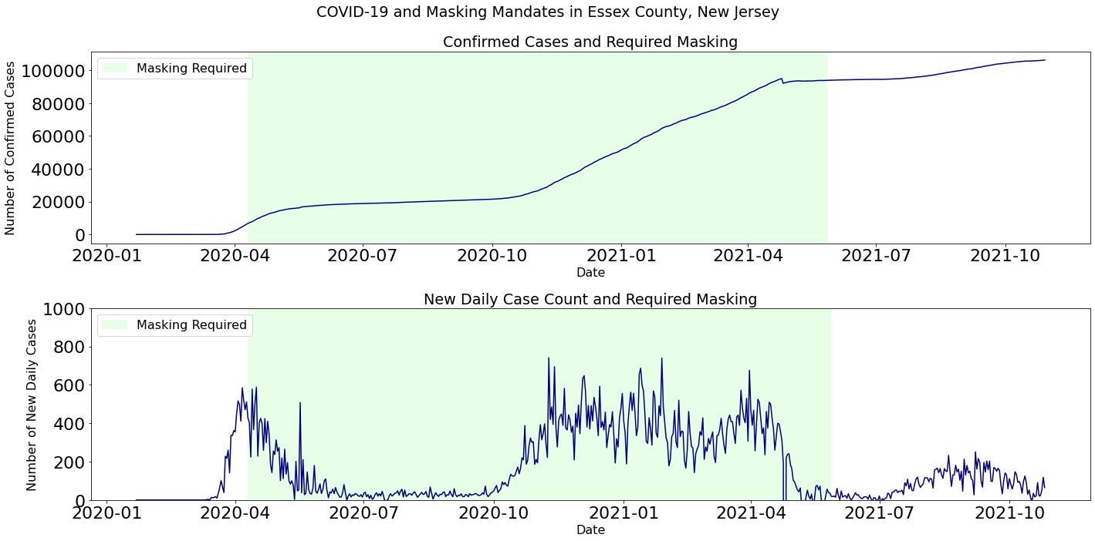
Motivation
In Essex County, New Jersey, COVID-19 spread rapidly in early 2020.
Effective March 18th, 2021, all schools in New Jersey were closed for the remaining school year. Source: School responses in New Jersey to the coronavirus (COVID-19) pandemic
The impact of a school closure and of students who now have a 4-month gap in their education is still largely unknown.

Slide 4
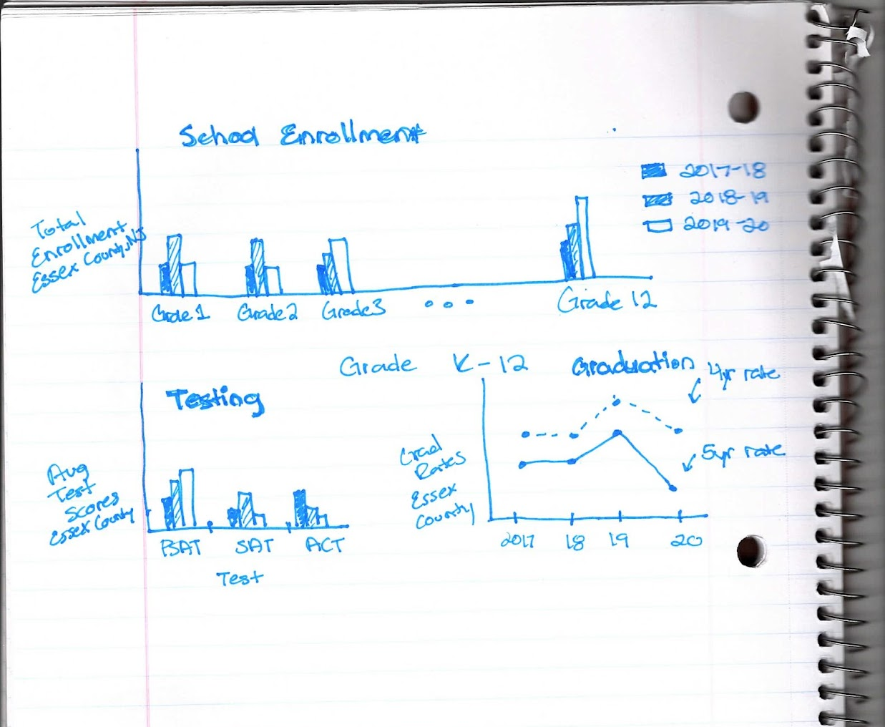
Methodology
Build an interactive dashboard that highlights
School Enrollment
Test Scores
Graduation Rates
Dataset Source: New Jersey School Performance Report from the Official Site of the State of New Jersey (2017-18, 2018-19, and 2019-20 school years)
Dataset Source Link: https://rc.doe.state.nj.us/download

Slide 5
LIMITATIONS
Potential data issues
Cancellation of tests and changes in testing requirements due to COVID-19
Delays in graduation and changes in graduation requirements due to COVID
It is unknown if some schools administered different policies when it came to how they handled the pandemic
Data access
Ideally this analysis would contain data from the 2020-2021 school year (currently only data publicly available goes up to the 2019-2020 school year)
Private school data (this analysis only used public school data)

Slide 6
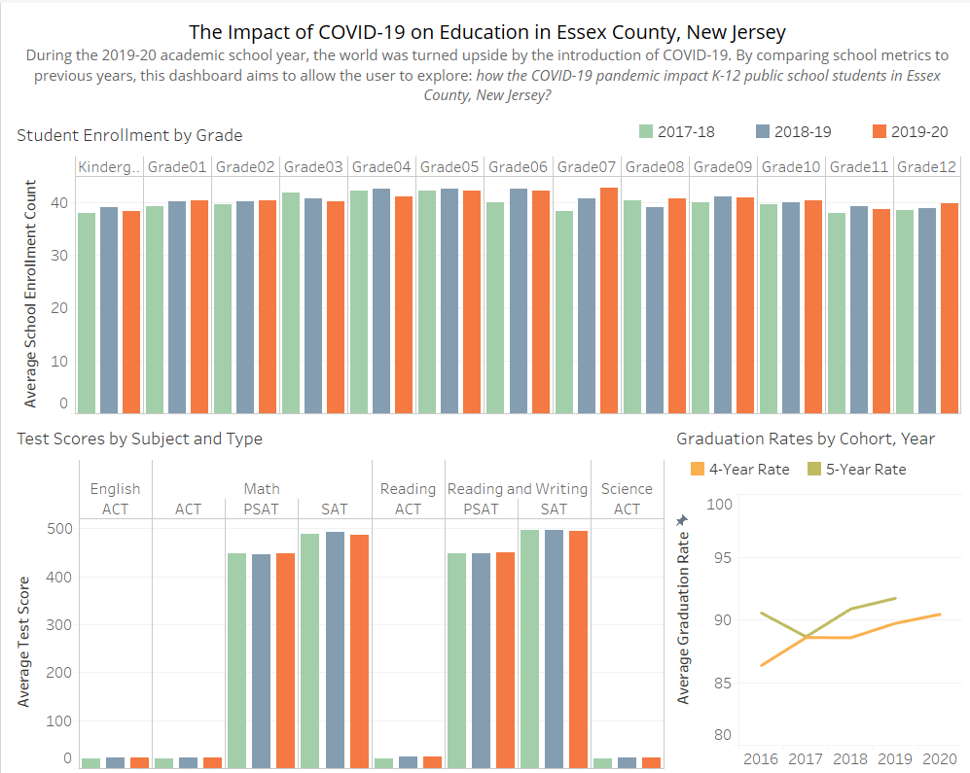
Final Product
Publicly available on Tableau Public
Interactive dashboard: filterable, sortable, and tooltips display additional details
Highlights the changes in school averages over the last few years

Slide 7
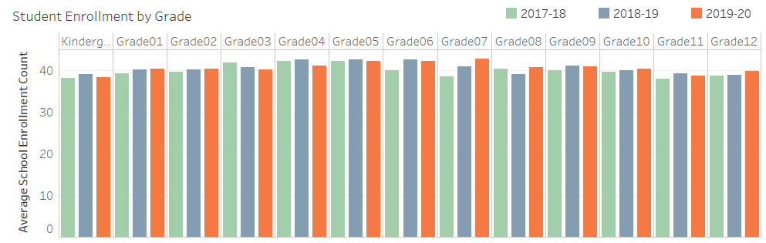
Add a Slide Title - 1

Slide 8
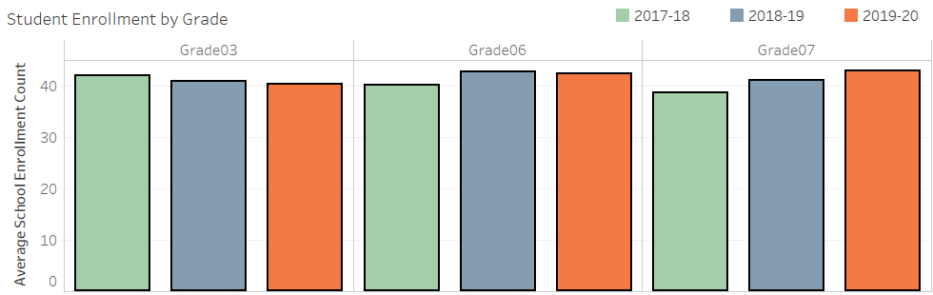
RESULTS Grades with the largest changes in average enrollment
Grade | 2017-2018 | 2018-2019 | 2019-2020
Grade 3 | 41.88 | 39.60 | 32.41
Grade 6 | 40.72 | 42.63 | 40.81
Grade 7 | 40.20 | 42.20 | 42.82

Slide 9
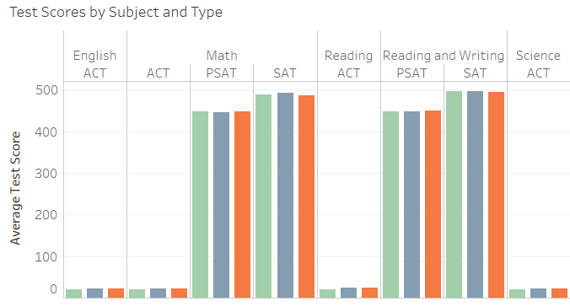

Slide 10
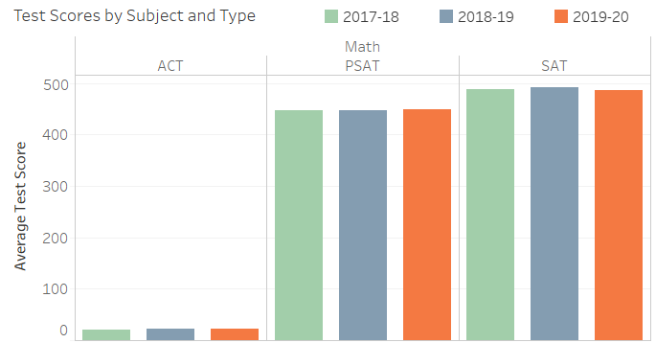
RESULTS Tests with the largest change in average score
Math Test | 2017-2018 | 2018-2019 | 2019-2020
ACT | 20.27 | 22.61 | 22.30
PSAT | 448.14 | 446.88 | 448.89
SAT | 486.65 | 491.74 | 486.65

Slide 11
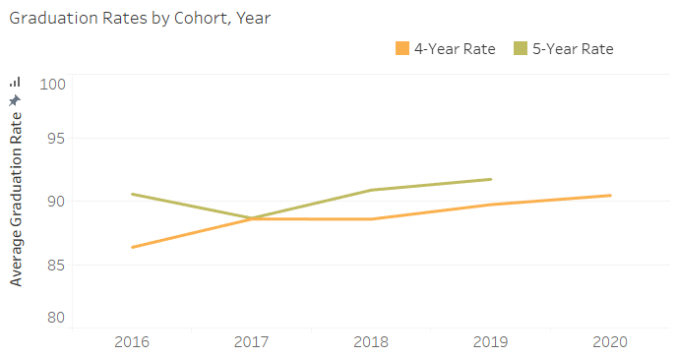
RESULTS
Graduation Rates actually increased in 2020
Graduation Year | Graduation Rare (4-Year)
2016 | 86.4%
2017 | 88.6%
2018 | 88.6%
2019 | 89.7%
2020 | 90.4%

Slide 12

In Conclusion…

